Slide 1
Fetal Development, pregnancy and ultrasound
ANNIS FELICIEN MSN,RN NURSE MANAGER

Slide 2
God our Creator
For by him were all things created, that are in heaven, and that are in earth, visible and invisible, whether they be thrones, or dominions, or principalities, or powers: all things were created by him, and for him: Colossians 1:16
So, God created man in his own image, in the image of God created he him; male and female created he them. Genesis 1:27
Before I formed thee in the belly, I knew thee; and before thou camest forth out of the womb I sanctified thee, and I ordained thee a prophet unto the nations. Jeremiah 1:5
Notes:
Here are a few scriptures references we can look to see and understand that God is our creator, and it is him that gives each one of us life.

Slide 3
OBJECTIVES
The learner will be able to state the fertilization steps that produces a pregnancy
The learner will be able to list the stages of fetal development
The learner will be able to state three reasons for ultrasounds performed at PRCE
Notes:
In this presentation we are going to be discussing pregnancy and how a woman becomes pregnant, the stages of fetal development and reasons we perform ultrasounds at PRCE.

Slide 4
Pregnancy
A World View versus The Bible View
Notes:
LET US TAKE A LOOK AT THE ANATOMY OF THE REPRODUCTIVE SYSTEM

Slide 5
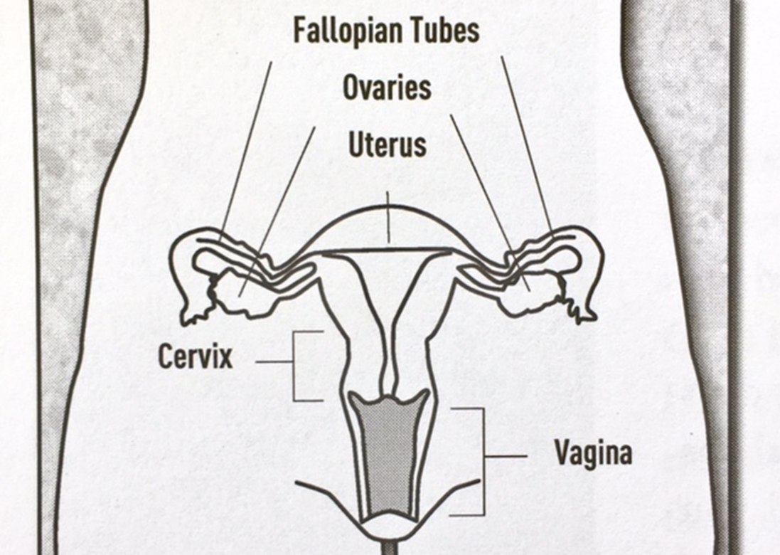
PREGNANCY : FEMALE REPRODUCTIVE ANATOMY
FUNCTION OF THE FEMALE ANATOMY
Notes:
Uterus – (womb) hollow and shaped like upside-down pear. At bottom, cervix opens into the vagina, which leads to the exterior of the female. Home of the unborn child. Walls are made of muscles that can expand with growth of child and contract to push baby downward during L&D
Ovaries – size and shape of almond about 1.5 inches. 2 functions: produce eggs and hormones. Those hormones control the female body characteristics and regulate menstrual cycle and pregnancy.
Fallopian Tubes – attached at either side of the uterus and have finger-like projections reaching to ovaries. They serve as passageways through which the eggs travel from ovary to uterus.

Slide 6
PREGNANCY: HOW IT ALL BEGINS
Ovulation
(egg is released)
Fertilization
(egg and sperm unite)
Pregnant
Implantation
(embryo inhabits uterus)
Pregnant
No Implantation
End of Pregnancy
No Fertilization
Not Pregnant
Menstruation
Not Pregnant
Notes:
Pituitary gland in the woman’s brain sends hormones to stimulate the ovaries to release an egg. Those hormones also thicken and prepare the lining of the uterus for a potential pregnancy. Pregnancy triggers more hormones, which tell the uterus to maintain its ready state. If pregnancy does not occur, the uterus will shed its blood-filled lining and pass out the body (menstruation) with flow continuing 3-7 days. Cycle is repeated once a month and varies woman to woman, avg. 21-35 days.
(Demonstration with rolled bread and rice grains) About 2 wks after a woman’s menstruation begins, ovary releases an egg (Ovulation). Egg and sperm meet in the fallopian tube. Sperm unites with the egg the greatest potential for fertilization is within 24 hrs of the egg’s release. When fertilization (or conception) occurs, miracle of life begins. The fertilized egg (embryo) beginning as one cell – rapidly multiplies and divides and travels through the fallopian tubes. The fertilized egg then makes it’s way into the uterus and implantation occurs. 12% of fertilized eggs fail to implant. Occasionally the fertilized egg wrongly implants in the fallopian tube or elsewhere and this is called ectopic or tubal pregnancy. Dangerous situation that requires medical attention.

Slide 7
PREGNANCY SYPMTOMS
Breast tenderness or enlargement
Nipple sensitivity
Frequent urination
Fatigue
Nausea and vomiting
Feeling bloated
Cramps
Decreased or increased appetite
Moodiness or heightened emotion
A lighter or shorter menstruation than usual
A missed menstruation
Notes:
Although these are common in women who are pregnant, many women also regularly experience these symptoms when approaching menstruation AND common in people who are worried, anxious, or very stressed. That’s good to know to remind your negative pregnancy test client.

Slide 8
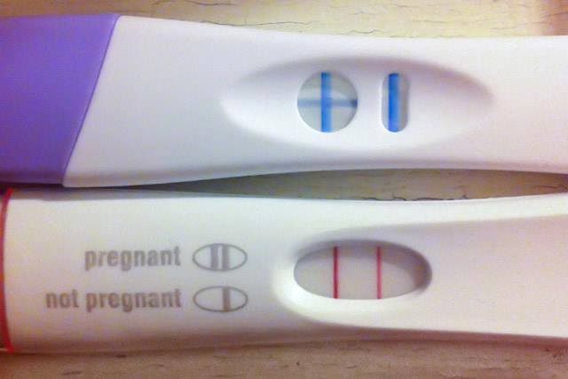
PREGNANCY TEST
Measures levels of hCG (Human Chorionic gonadotropin) hormone
hCG is produced during pregnancy and found in the blood and urine.
Negative Test Does NOT mean “not pregnant”
Positive means sufficient levels of hCG are present- even with a light line
Notes:
Once implantation occurs, the woman produces a hormone called hCG (human chorionic gonadotropin) and that is the only time she will ever have that hormone within her bloodstream. It’s detected in urine too and that’s why we see two lines on the positive pregnancy tests we provide for our clients.

Slide 9
BIRTH CONTROL: OUR POLICY
Not Covering in-depth
Natural Family Planning
Barrier Contraceptives
Hormonal Contraceptives
Emergency Contraceptives
At PRCE
We do not refer, provide, or recommend any birth control methods at our center.
For unmarried couples, abstinence is the only way to honor God and avoid the negative physical, spiritual, and emotional consequences of acting outside of God’s plan for sex.
For married couples, it’s both a spiritual decision as they seek God’s will for their lives and a medical decision to make with their physician
Notes:
Life begins at fertilization, not at implantation. There are several birth control methods that have the potential to destroy a fertilized egg or prevent it from implanting and that is viewed as an abortifacient. However, there is controversial, inconclusive evidence at this time regarding how some methods work on the woman’s body.
Also, all forms of pregnancy prevention have a level of failure, except for abstinence

Slide 10
Fetal Development
Our Creator’s Work

Slide 11
TRIMESTERS
First Trimester
  Weeks 1- 13
Second Trimester
  Weeks 14-26
Third Trimester
  Weeks 27-40

Slide 12
First Trimester Milestones (weeks 1- 13)
Week 1 (Day 1) – First day of last normal menstrual period. (Conception takes place 2 weeks later)
Week 2 (Day 14) – Egg released from ovary, then fertilization - Every detail of development including: sex, hair color, and eye color determined at this point.
Week 5 – Embryo’s brain, spinal cord, and nervous system begin to form. The heart begins to pump blood with a unique blood type.
Week 6 – All internal organs present and forming – heart-beat can be seen and heard on ultrasound.
Week 7 – Arms, hands with finger buds, and legs with feet and toe buds are visible.
Week 8 – Brain activity is measurable. Embryo shows reflexive response to touch and begins to move. Week 11 – Internal organs are functioning. Now called a “fetus”. Changes after this week are primarily changes in size, rather than in appearance.

Slide 13
Second Trimester Milestones (weeks 14-26)
Week 14 - The fetus moves vigorously and can make a tight fist. The sex of the child can be determined.
Week 18 - There is evidence the baby can feel pain. The baby begins to hear.
Week 22 - Head and body hair are visible. The fetus jumps in response to loud noises. He or she can now swallow.
Week 24 – If the baby was born during this month and given special care, he or she could survive.

Slide 14
Third Trimester Milestones (weeks 27-40)
Weeks 36-40 – The fetus experiences rapid weight gain and is ready for birth.
Notes:
All the baby’s development at this point is the addition of fat deposits.

Slide 15
Ultrasound
PRCE’s specifics

Slide 16
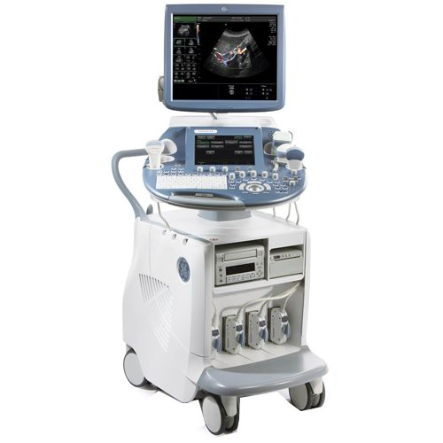
HOW ULTRASOUND WORKS
Soundwaves (echoes) travel through the urine in the bladder to the uterus.
Echoes travel to a change in tissue and it’s reflected
The probe picks up the reflected waves & calculates the distance and speed of the echoes to produce a 2D or 3D image.
Can take measurements of the image, determine age of fetus, and uncover simple health facts

Slide 17
WHY VALUABLE IN PROLIFE ARENA:
Ultrasounds save lives!
Historically- Abortion Advocates
Described the beginning of pregnancy as a “blob of tissue” – The baby to them had no form and therefore was not alive
Can Easily See Heart Beating
Has profound effect on one considering abortion. From “I have a problem” to “I have a baby”
Abortion Deterrent
78% of women undecided on abortion chose life after seeing the fetus on ultrasound
Notes:
(the 3rd box) According to a poll by Focus on the Family – (reference: Adam Cohen“The Next Abortion Battleground: Fetal Heartbeats” Time Ideas October 17, 2011)
(mention handout of Care Net blog from Dr. Sandy Christiansen - Why Ultrasounds Matter for Women Planning Abortion as it describes most recent large study on women considering abortions and seeing the ultrasound beforehand and the implications it has on Pregnancy Centers. http://affiliates.care-net.org/Education/Center-Insights-Library/Post/201

Slide 18
PRCE’s Practice of Ultrasound
Eligible between 6-18 weeks
Gestational Aging (can find out exactly how far along she is)
Multiple Gestation? (does she have twins or triplets?)
Pregnancy Viability (ectopic? no heartbeat?)
Tag team with Client Advocate - Gospel and Godly life-style encouragement
Notes:
High quality care with top medical standards (GUS/disinfection practices)
(app)
(fetal models)
(prayer bears)
(picture holder)
Something to also think about more than 70 % of the women who have gone ahead with an abortion when survey reported the baby’s father reaction/support was a major deciding factor in that decision. Yet we only hear the ones who are yelling the loudest “my body ,my choice”-Cre net conference 2021.

Slide 19
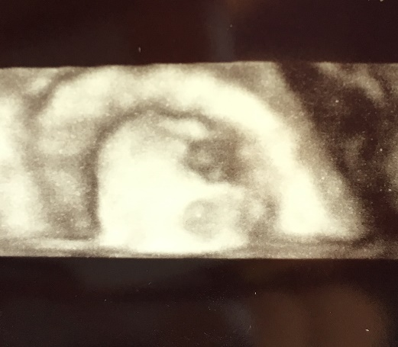
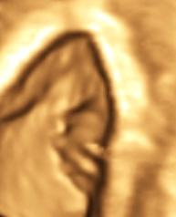
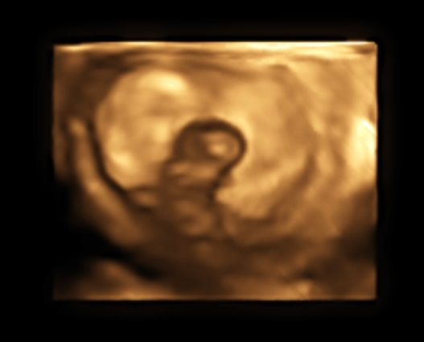
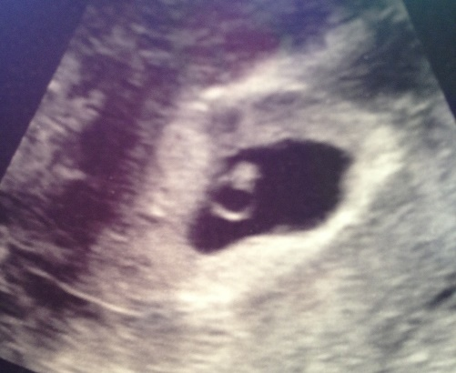
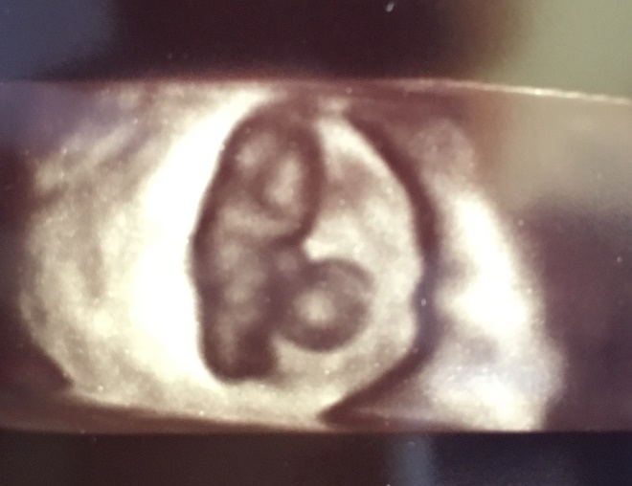
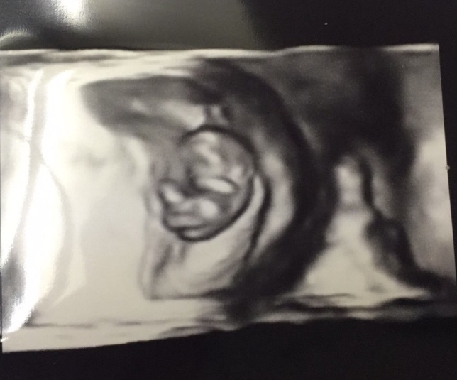
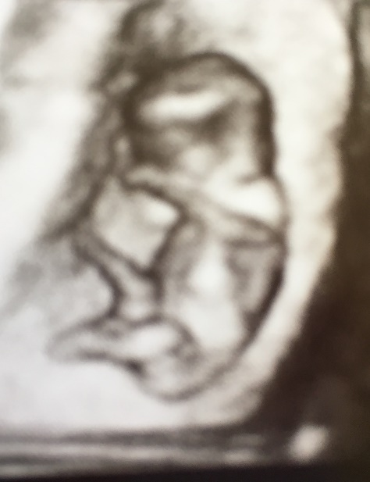
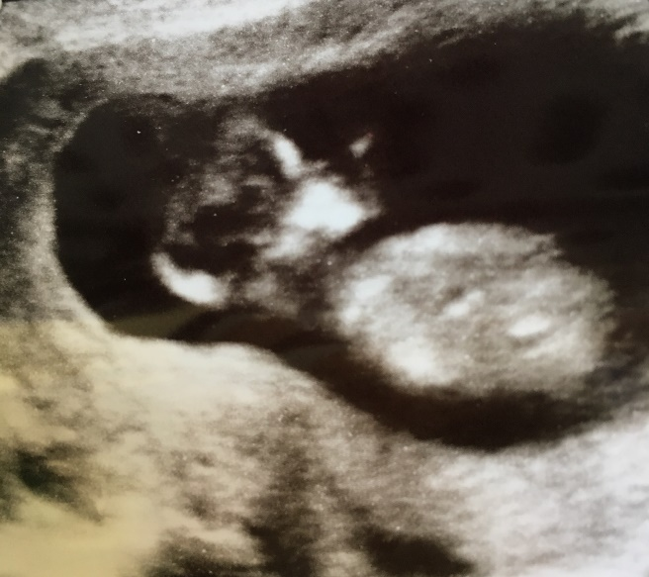
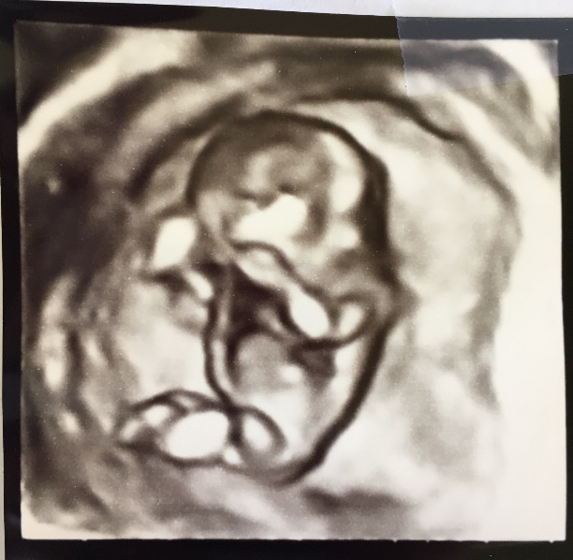
Some pictures from PRCE’s ultrasounds
7 weeks 0.4 in
8 weeks 0.5 in
9 weeks 0.8in
6 weeks 0.5cm
6 weeks 0.5cm
2D
3D
3D
3D
3D
10 weeks 1.2 in
9 weeks 0.8in
11 weeks 2.4in
12 weeks 3in
3D
3D
2D
3D

Slide 20
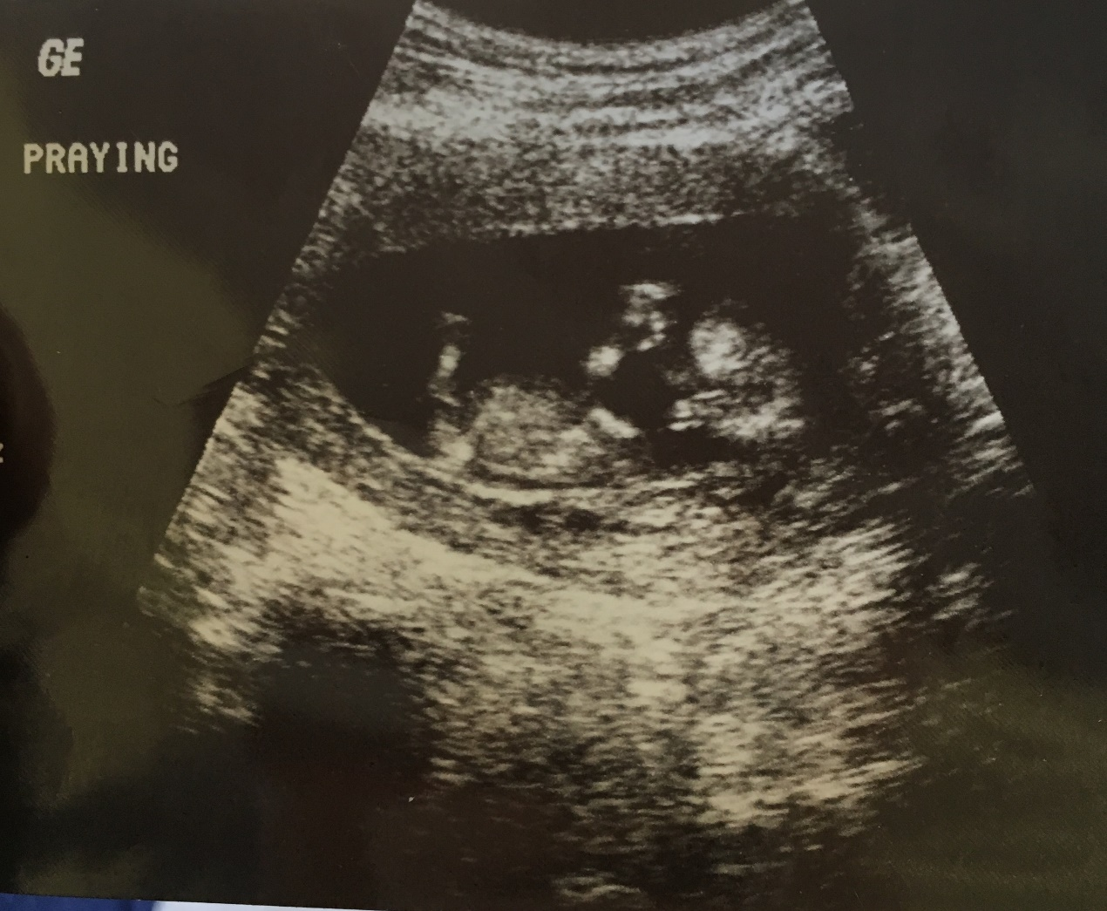
PRCE baby client praying
Notes:
I want to close out with one of my favorite verses:
Children are a heritage from the LORD,
offspring a reward from him.
Psalm 127:3

Slide 21
WORK CITED
@adamscohen, Adam Cohen. "The Next Abortion Battleground: Fetal Heartbeats." Time. Time, 17 Oct. 2011. Web. 07 Apr. 2017.
www.biblegateway,com/ King James Versions. Web. 08 November 2021
Life International. Intimacy Before Impact: Preparing the Heart and Mind for Life-Giving Ministry. 2nd ed. Grand Rapids: Frontlines Publishing, 2014. Print.
Dr. Sandy Christiansen. "Why Ultrasounds Matter for Women Planning Abortion." Web log post. Care Net. N.p., 5 Dec. 2014. Web. 7 Apr. 2017. <http://affiliates.care-net.org/Education/Center-Insights-Library/Post/201>. Adapted from Medical Insights (February 2014), a publication of Care Net.

Slide 22

This Photo by Unknown Author is licensed under CC BY-NC

